Slide 1
FUN with Fourier transforms
BIT Course Image Processing, Retrieval and Analysis
Prof. Dr. Christian Bauckhage
Students: Ola Al Naameh, Arul Selvam, Tatiana Novikova, Fida Mohammad, Can Yuce, Oguz Uzman, Amal Amouri

Slide 2
The Fourier transform decomposes a function of time (a signal) into the frequencies that make it up, in a way similar to how a musical chord can be expressed as the amplitude (or loudness) of its constituent notes.*
* Source: https://en.wikipedia.org/wiki/Fourier_transform

Slide 3


Generalities
Implementation of the solution is in Python.
Using NumPy and SciPy modules.
Anaconda package (not obligatory).
Students: Ola Al Naameh, Arul Selvam, Tatiana Novikova, Fida Mohammad, Can Yuce, Oguz Uzman, Amal

Slide 4


Fourier transform ver.1
What does the Fourier Transform do? Given a smoothie, it finds the recipe.
How? Run the smoothie through filters to extract each ingredient.
Why? Recipes are easier to analyze, compare, and modify than the smoothie itself.
How do we get the smoothie back? Blend the ingredients!
Students: Ola Al Naameh, Arul Selvam, Tatiana Novikova, Fida Mohammad, Can Yuce, Oguz Uzman, Amal

Slide 5
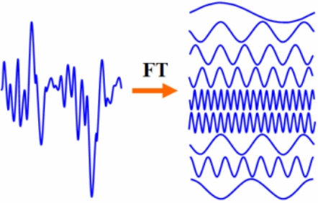
Fourier transform ver.2
Here's the "math" version of the previous slide: The Fourier Transform takes a time-based pattern, measures every possible cycle, and returns the overall "cycle recipe" (the amplitude, offset, rotation speed for every cycle that was found).
Students: Ola Al Naameh, Arul Selvam, Tatiana Novikova, Fida Mohammad, Can Yuce, Oguz Uzman, Amal

Slide 6
Task 1

Slide 7
Task 1.1: warm-up
Why?
Getting familiar with simple intensity images.
How?
Reading an intensity image into a 2-dimensional array.
Calculate the width and height of the image.
Calculate the euclidean distance of each pixel from the centre.
Suppress all the pixels whose distance is greater than an arbitrary R min and less than R max.
A Python Code Sample
res = np.array([[0 if r_min <= np.linalg.norm([x-(h/2.0), y-(w/2.0)]) <= r_max else img[x, y] for y in range(w)]\for x in range(h)], dtype=np.uint8)
Notes:
Hai

Slide 8
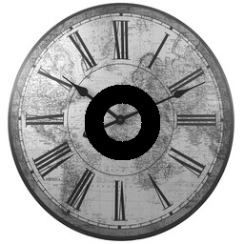
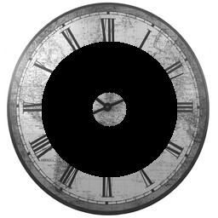
Task 1.1: warm-up
Results
Rmin = 20, Rmax = 40
Rmin = 20, Rmax = 80
We learnt how to work with digital images like reading, writing and selecting individual pixels
Notes:
Hai

Slide 9
Task 3

Slide 10
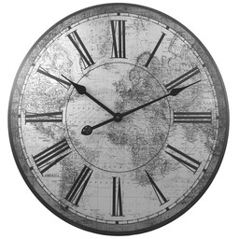


Task 1.3: Implementing a band pass filter
Why? Implementing a band pass filter
How?
Perform Fourier transform on the images.
Shift the zero-frequency spectrum to the center.
The pixels which are closer to the center than rmin and further than rmax are set to 0. Thus, suppressed.
log(abs(G))
log(abs(fftshift(G)))

Slide 11
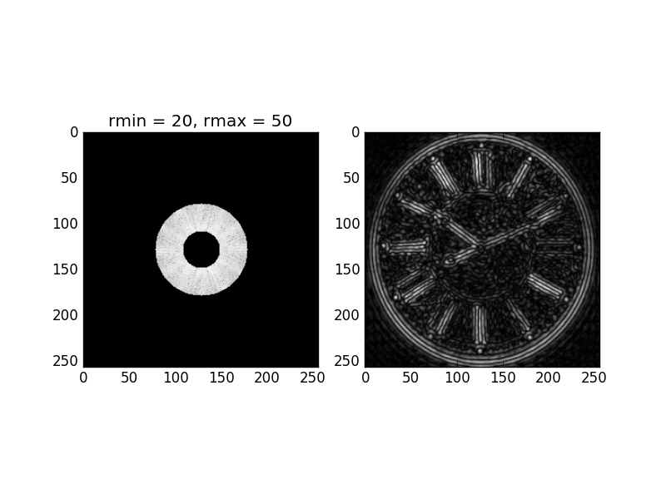
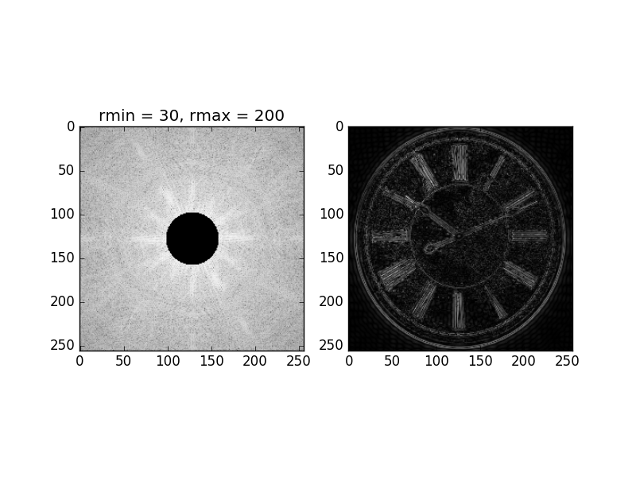
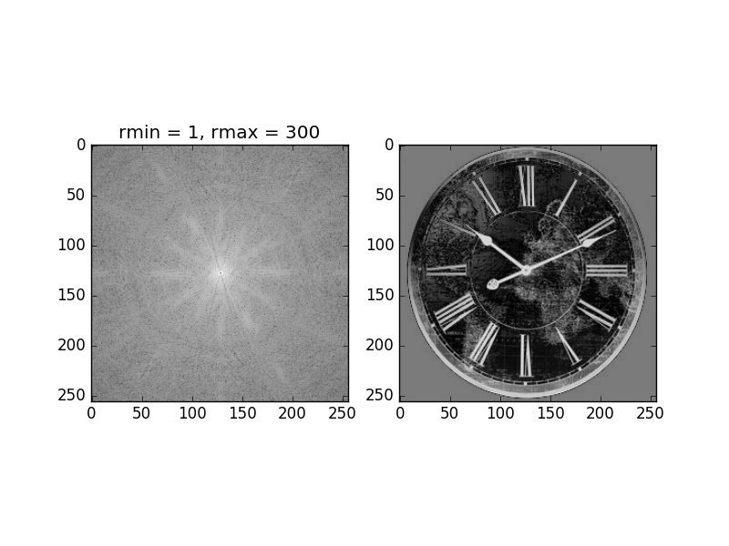
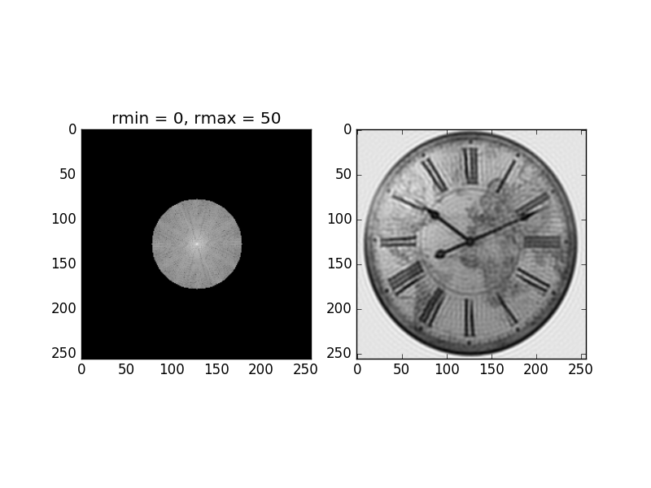
Task 1.3: Implementing a band pass filter
Results

Slide 12
Task 1.3: Implementing a band pass filter
Results
The lower frequencies contain ‘more important’ details about the image.
Removing zero frequency changes image drastically.
Removing some of the highest frequencies reduces some edge sharpness, but their effects aren’t as visible until many of them are removed.

Slide 13
Task 4

Slide 14
Task 1.4: exploring the importance of phase
Why?
Exploring the importance of phase.
How?
Calculate Fourier transforms G and H of images g(x,y) and h(x,y).
Calculate the Magnitude of G by taking the absolute of every pixel in G.
Calculate the Phase of H by calculating the angle between imaginary and real parts of H.
Recalculate Real and Imaginary components and apply IFFT.

Slide 15
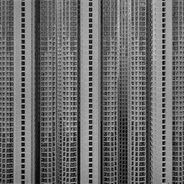

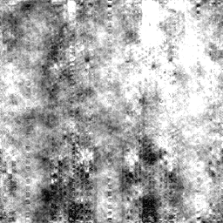
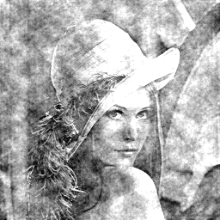
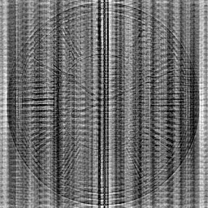
Task 1.4: exploring the importance of phase
building.png
clock.png
lena.png
Phase of building.png’ and magnitude of ‘clock.png’.
Phase of ‘lena.png’ and magnitude of ‘clock.png’.
Phase of ‘clock.png’ and magnitude of ‘building.png’

Slide 16
Task 1.4: exploring the importance of phase
Results
The phase component influences the reconstructed image more than the magnitude component does.
The magnitude component is similar for most of the natural occurring images but phase component varies a lot.
Image features are related with the phase component.
Thus phase component is more important while reconstructing the images.

Slide 17
Conclusion
Implementation...
Using NumPy and SciPy modules helped to..
Students: Ola Al Naameh, Arul Selvam, Tatiana Novikova, Fida Mohammad, Can Yuce, Oguz Uzman, Amal

Slide 18
Thanks!
Any questions?

